Slide 1

FINANCIAL HEALTH COPILOT
From transactions to action
Team: Ctrl Alt Elite
Member Name 1: Gauri Deshpande
Member Name 2: Nehali Shelar
Member Name 3: Anant Hejib
Notes:
Source: FIN Financial Health Copilot Hackathon Project Document supplied by the team.

Slide 2


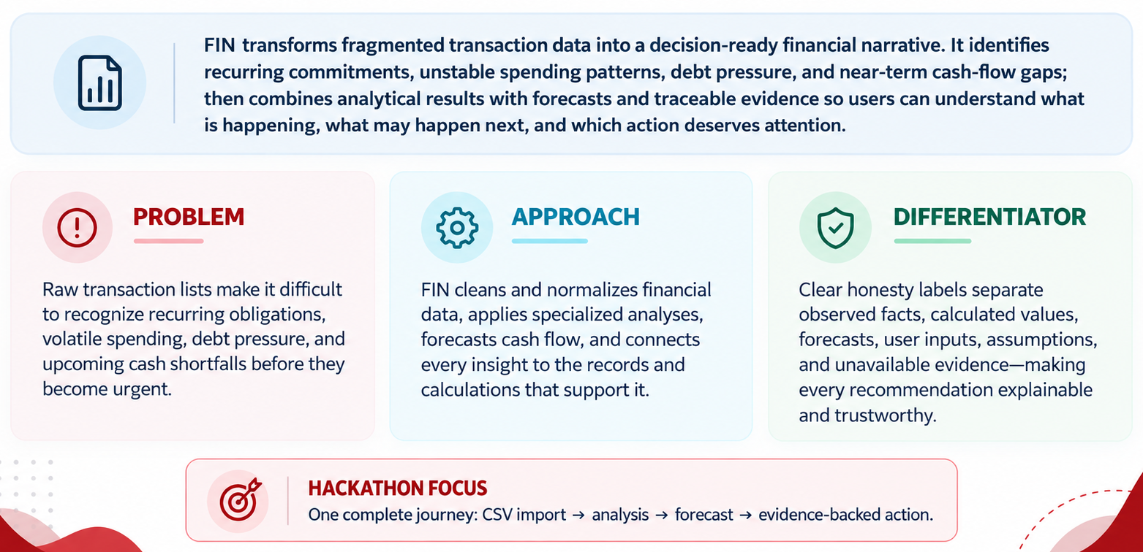
ABSTRACT
Notes:
Source: Executive summary, problem statement, solution concept, and honesty-label sections in the supplied project document.

Slide 3
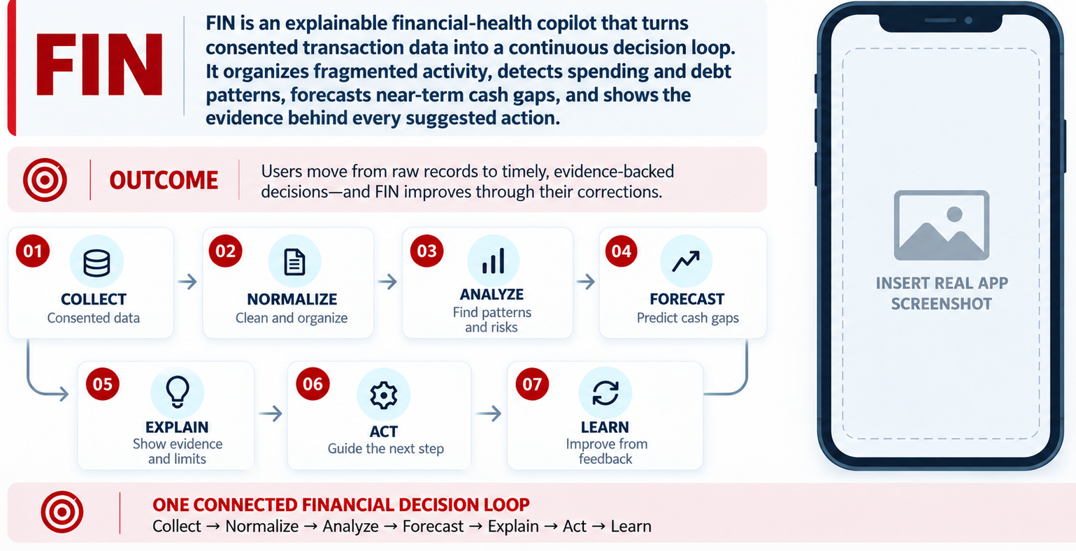
IDEA OVERVIEW
Notes:
Source: Core loop and MVP rule in the supplied project document.

Slide 4
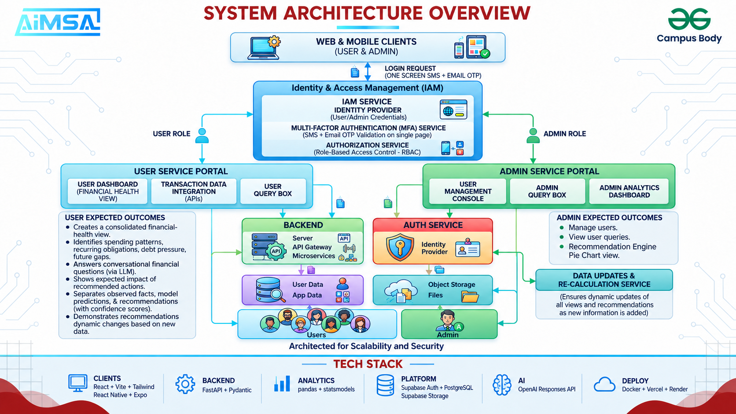
TECHNICAL APPROACH
Notes:
Primary source: supplied WhatsApp system architecture image. Supporting terminology: technical architecture section of the supplied project document.

Slide 5
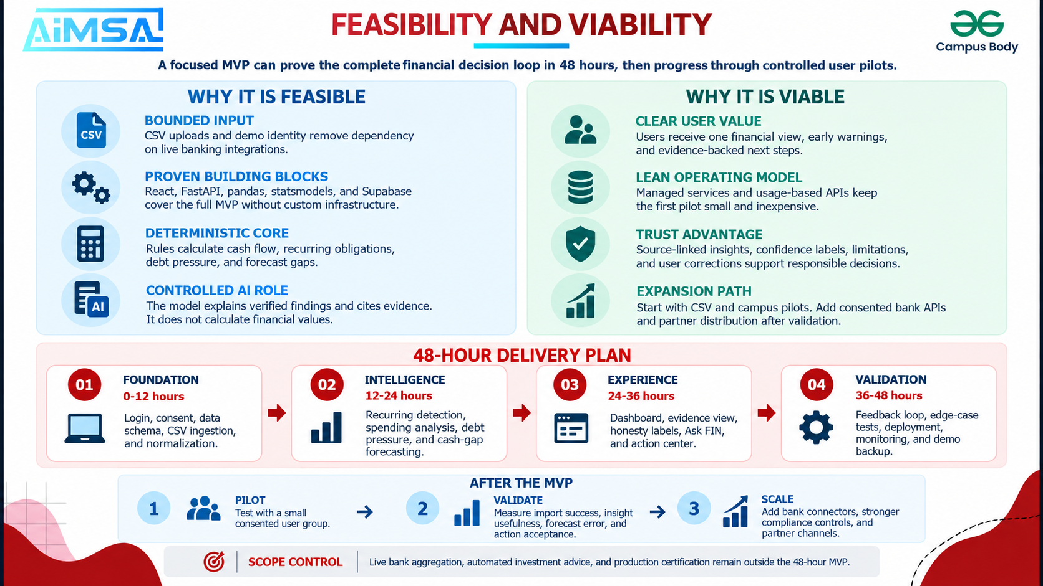
Notes:
Source: Hackathon MVP scope and build plan in the supplied project document. All timelines are proposed targets.

Slide 6
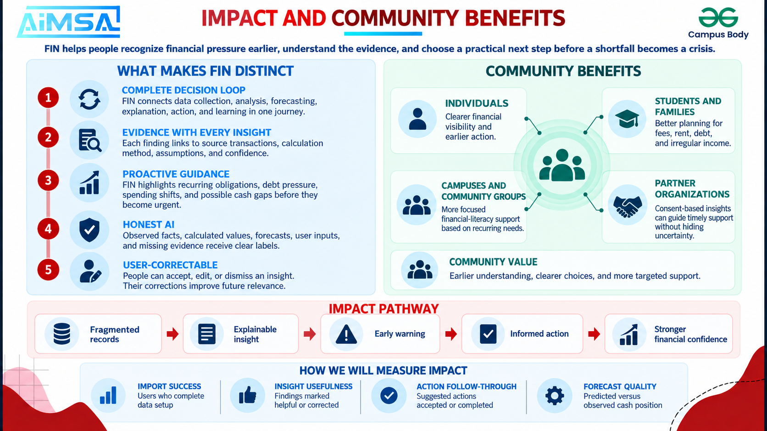
Notes:
Sources: user and admin outcomes in the supplied architecture image; evaluation metrics in the supplied project document. Metrics are proposed, not measured results.

Slide 7

RESEARCH AND REFERENCES
Notes:
This deck uses only the supplied project document, architecture image, and presentation template. No external factual claims were added.

